Slide 1
ALUMNI
2023

Slide 2
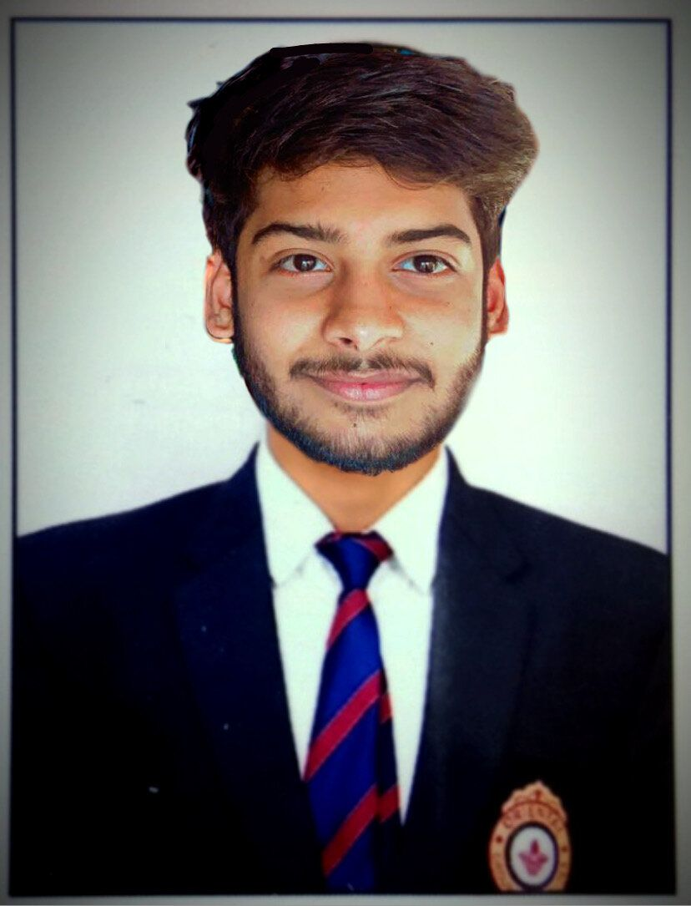
Himanshu Singour
SOFTWARE DEVELOPMENT ENGINEER
@
AMAZON

Slide 3
Himanshu Singour
SOFTWARE DEVELOPMENT ENGINEER
@
AMAZON

Slide 4
Himanshu Singour
SOFTWARE DEVELOPMENT ENGINEER
@
AMAZON

Slide 5
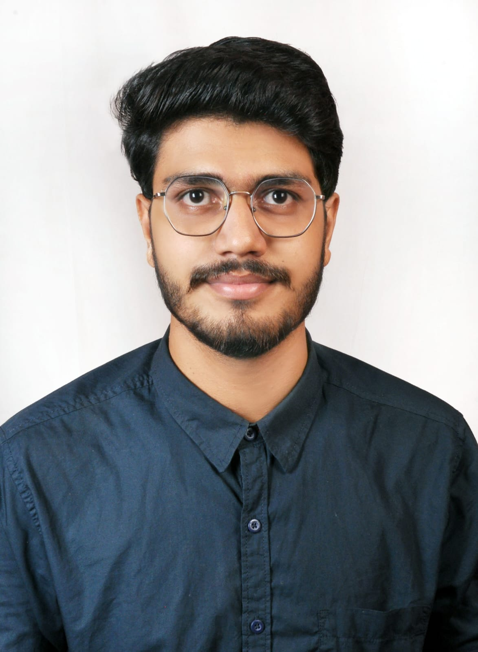
Ritik Sankhpal
PROJECT AND QUALITY TEST ENGINEER
@
WIPRO TECHNOLOGIES

Slide 6
Ritik Sankhpal
PROJECT AND QUALITY TEST ENGINEER
@
WIPRO TECHNOLOGIES

Slide 7
Ritik Sankhpal
PROJECT AND QUALITY TEST ENGINEER
@
WIPRO TECHNOLOGIES

Slide 8
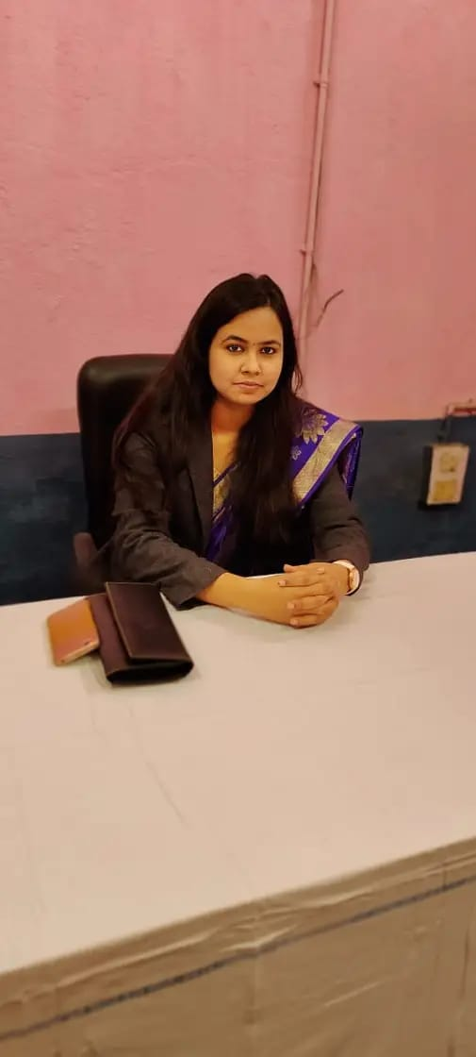
Nishi Aryan
ELECTRICAL ENGINEER (SUPERVISOR)
@
INDIAN RAILWAYS,
GOVT. OF INDIA

Slide 9
Nishi Aryan
ELECTRICAL ENGINEER (SUPERVISOR)
@
INDIAN RAILWAYS,
GOVT. OF INDIA

Slide 10
Nishi Aryan
ELECTRICAL ENGINEER (SUPERVISOR)
@
INDIAN RAILWAYS,
GOVT. OF INDIA

Slide 11
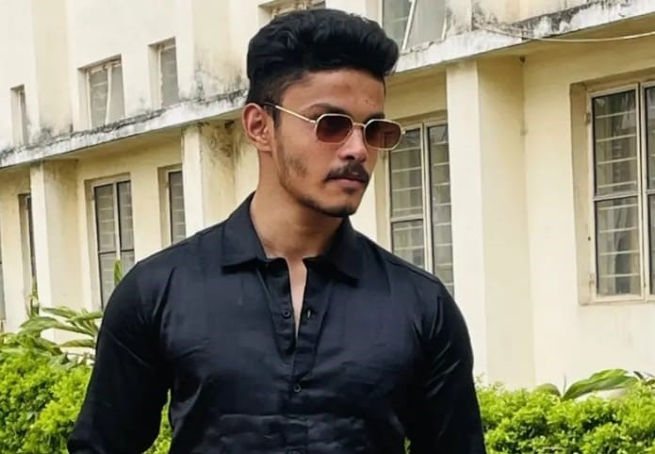
Anubhav Jain
ELECTRONIC SALES ENGINEER
@
OT SOLUTIONS TECH PVT. LTD.

Slide 12
Anubhav Jain
ELECTRONIC SALES ENGINEER
@
OT SOLUTIONS TECH PVT. LTD.

Slide 13
Anubhav Jain
ELECTRONIC SALES ENGINEER
@
OT SOLUTIONS TECH PVT. LTD.

Slide 14
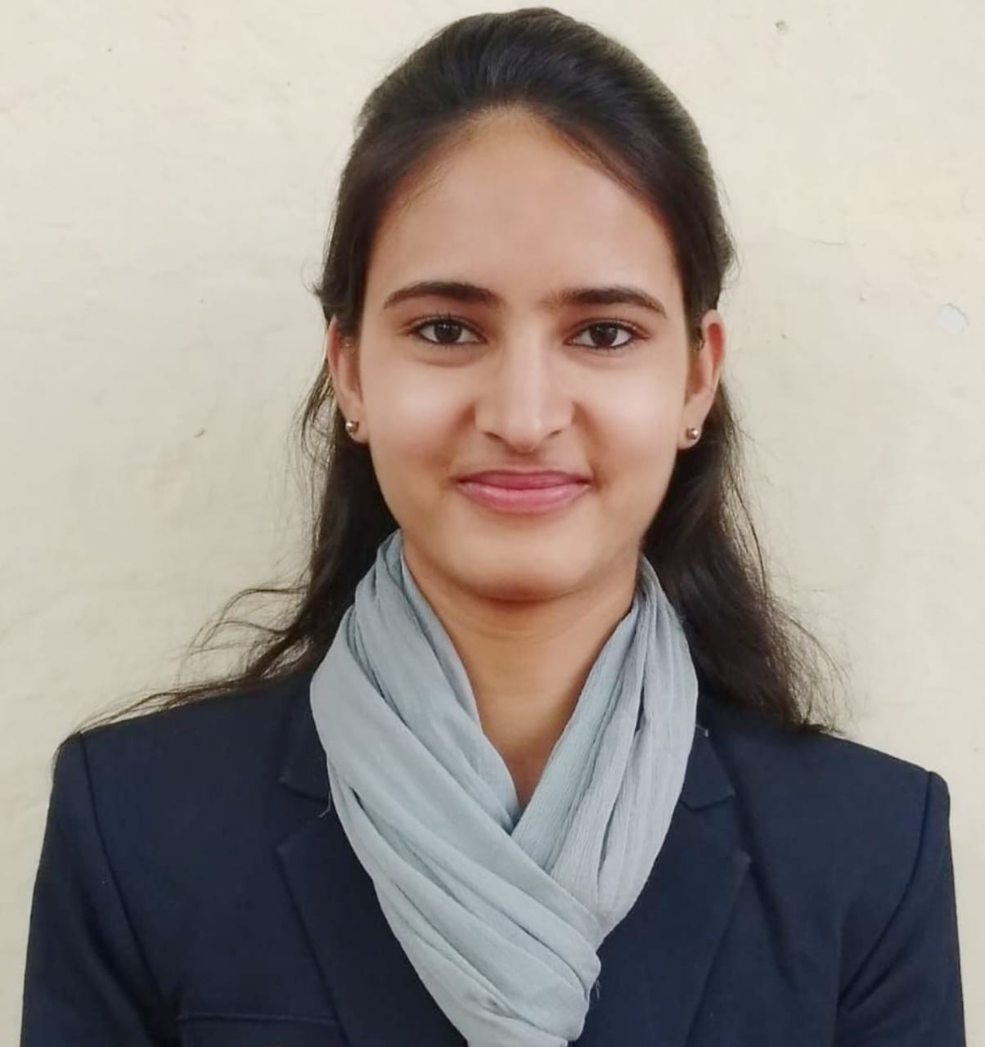
Vijay Lakshmi
ANALYST OF CORE BUSINESS OPERATION
@
DELOITTE

Slide 15
Vijay Lakshmi
ANALYST OF CORE BUSINESS OPERATION
@
DELOITTE

Slide 16
Vijay Lakshmi
ANALYST OF CORE BUSINESS OPERATION
@
DELOITTE

